Slide 1

Real-Time Pedestrian Detection in Autonomous Systems using Deep Learning
by
Harshith Raj P
Roll No. 224G1A3327
Shaik Aliya
Roll No. 224G1A3303
Om Pradeep P
Roll No. 224G1A3365
Neeraj G
Roll No. 224G1A3362
Under the guidance of
^{Mr. A. Kiran Kumar}M. Tech.
Assistant Professor
Department of Computer Science and Engineering (AI & ML)
Srinivasa Ramanujan Institute of Technology
(Affiliated to JNTUA & Approved by AICTE) (Accredited by NAAC with ‘A’ Grade & Accredited by NBA (EEE, ECE & CSE)
Rotarypuram Village, B K Samudram Mandal, Ananthapuramu – 515701.
2025 - 2026
Srinivasa Ramanujan Institute of Technology

Slide 2
Contents
Real-Time Pedestrian Detection in Autonomous Systems using Deep Learning
Abstract
Introduction
Literature survey
Proposed Work
References
GitHub Link
Queries
Srinivasa Ramanujan Institute of Technology

Slide 3
Abstract
Real-Time Pedestrian Detection in Autonomous Systems using Deep Learning
Pedestrian detection plays a pivotal role in autonomous systems, directly impacting safe navigation and collision avoidance. With the evolution of deep learning, YOLO (You Only Look Once) models have become prominent for real-time object detection, particularly in dynamic environments. This research surveys the YOLO framework with a focus on YOLOv8, highlighting its strengths in speed and accuracy while identifying persistent limitations in detecting partially occluded, small-scale, and densely clustered pedestrians. To address these challenges, we introduce four enhanced architectures—YOLOv9—incorporating adaptive attention mechanisms, multi-scale feature fusion, and temporal context modeling to improve detection robustness. Our methodology involves extensive benchmarking across standard pedestrian datasets, evaluating performance metrics such as precision, recall, and mean average precision (mAP). Results demonstrate that the proposed models significantly outperform YOLOv8, especially in complex urban scenarios. These findings underscore the importance of architectural innovation in pedestrian detection and lay the groundwork for future advancements in autonomous navigation systems.
Srinivasa Ramanujan Institute of Technology

Slide 4
Introduction
Real-Time Pedestrian Detection in Autonomous Systems using Deep Learning
Importance of pedestrian detection in autonomous navigation.
Pedestrian detection ensures safe and reliable movement of autonomous vehicles by preventing collisions and enabling smart decision-making in dynamic environments.
Rise of deep learning and YOLO models.
Deep learning has transformed object detection, with YOLO models offering fast and accurate real-time detection, making them ideal for autonomous systems.
Motivation to improve detection in complex environments.
Real-world scenes involve occlusions, varying scales, and crowded areas—challenging YOLOv8’s performance. This motivates the need for enhanced models with better spatial and temporal understanding.
Srinivasa Ramanujan Institute of Technology

Slide 5
v
Real-Time Pedestrian Detection in Autonomous Systems using Deep Learning
Pedestrian Detection: Limitations of Existing Systems
Current Approach:
Based on YOLOv8 deep learning model
design with enhanced feature extraction
Effective for general object detection
Key Limitations:
Poor detection under occlusion, clutter, and low resolution
Reduced performance in low-light and complex backgrounds
Struggles with scale variation (small/distant pedestrians)
Lacks contextual understanding and motion adaptability
Difficulty distinguishing pedestrians from similar backgrounds
Not optimized for pedestrian-specific challenges
Limited robustness in dense, dynamic urban environments
Srinivasa Ramanujan Institute of Technology

Slide 6
Literature Survey
Real-Time Pedestrian Detection in Autonomous Systems using Deep Learning
No | Title | Author | Journal Name & Year | Methodology Adapted | Key Findings | Gaps
1. | A Survey of Deep Learning Approches for Pedestrian Detection in Autonomous Systems | Majdi Sukkar, Rajendrasinh Jadeja, Madhu Shukla | IEEE Acess Journal & 2024 | Deep Learning Techniques | Enchanced Detection Frameworks, Real Time Processing, Research Directions | Exploring these models on a diverse datasets which has low-visibility conditions, shadows, occlusions etc.,
Overview of YOLO evolution: YOLOv1 to YOLOv8.
Strengths of YOLOv8: speed, anchor-free detection.
Limitations: occlusion, small-scale pedestrians, cluttered backgrounds.
Related works: Caltech, CityPersons, CrowdHuman datasets.
Srinivasa Ramanujan Institute of Technology

Slide 7
Proposed System & Work
Real-Time Pedestrian Detection in Autonomous Systems using Deep Learning
Introduction of YOLOv9:
Cross-attention for occlusion.
Multi-scale fusion for size variation.
Temporal transformers for streams.
Hybrid enhancements for real-time deployment.
- Training on benchmark datasets with advanced augmentation.
Implementation
Data Collection: Caltech, CityPersons, CrowdHuman.
Preprocessing: Normalization, augmentation (spatial + photometric).
Training: AdamW optimizer, CIoU loss, mixed precision.
Evaluation: mAP@0.5, precision/recall, FPS.
Deployment: FastAPI interface, PyTorch models, Grad-CAM visualizations.
Srinivasa Ramanujan Institute of Technology

Slide 8
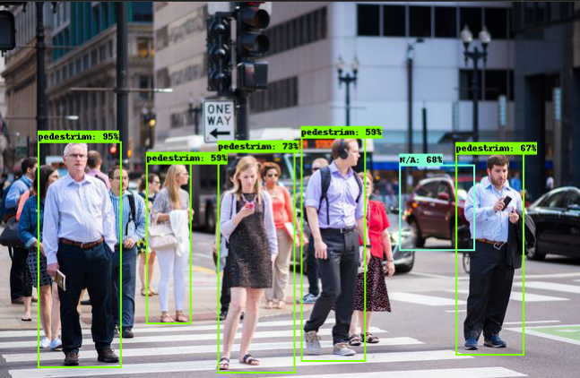
Results & Analysis
Real-Time Pedestrian Detection in Autonomous Systems using Deep Learning
Srinivasa Ramanujan Institute of Technology

Slide 9
Reference
Real-Time Pedestrian Detection in Autonomous Systems using Deep Learning
[1]. Majdi Sukkar; Rajendrasinh Jadeja; Madhu Shukla; Rajesh Mahadeva“A Survey of Deep Learning Approaches for Pedestrian Detection in Autonomous Systems”, Publisher IEEE, Date of Publication: 30 December 2024
Srinivasa Ramanujan Institute of Technology

Slide 10
Git Hub Dashboards of each student
Real-Time Pedestrian Detection in Autonomous Systems using Deep Learning
Repository Name Like: CSM 2025 – 26 Batch: A – 12
Under that project data upload literature survey papers, and son on..
Srinivasa Ramanujan Institute of Technology

Slide 11
Any Queries?
Real-Time Pedestrian Detection in Autonomous Systems using Deep Learning
Srinivasa Ramanujan Institute of Technology

Slide 12
Thank You!!!
Real-Time Pedestrian Detection in Autonomous Systems using Deep Learning
Srinivasa Ramanujan Institute of Technology

